Slide 1
Scraping it together
Leo Patterson Ross
#justfutures18

Slide 2
Data isn’t the future – it is all around us
What is changing is how we collect it
Data collection isn’t scary, or hard What is changing is how we use it

Slide 3
Question:
Are landlords over-using the NSW Civil and Administrative Tribunal?

Slide 4
Yes

Slide 5
Notes:
LL evictions – 54699, 82%
Guardianship, 10569, 18%
Admin 833, 1%
All other 766, 1% Professional tribunals mostly

Slide 8
Notes:
LL evictions – 54699, 82%
Guardianship, 10569, 18%
Admin 833, 1%
All other 766, 1% Professional tribunals mostly

Slide 9
The primary use of NCAT is to benefit landlords
Notes:
LL evictions – 24234, 40%
LL other – 6297, 11%
T 5391, 9%
All other consumer, 11822, 20%
Guardianship, 10569, 18%
Admin 833, 1%
All other 766, 1%

Slide 10
Limitations:
Data not available on individual landlords
Landlords know all the people they apply against but tenants only know it was them.

Slide 11
Solution:
NCAT publishes hearing lists
Illawarra Legal Centre 2012-13: Tracked Housing NSW teams making rent arrears applications.

Slide 12
What is scraping?
Collecting publicly accessible data… with robots.
Minimal resourcing:
a computer,
a coder,
an internet connection,
and your imagination

Slide 13
Uses
Journalists and activists – e.g. tracking parliamentary votes and disclosures, tracking Airbnb listings, tracking real estate listings
Commercial – price checking competitors, creating bad tenant databases, data harvesting social media usage

Slide 15
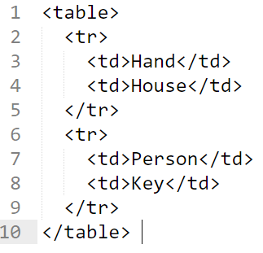
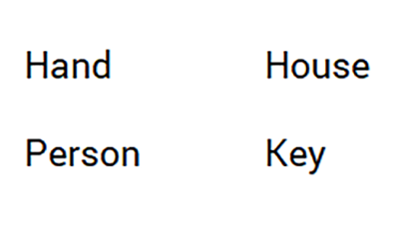

Slide 16
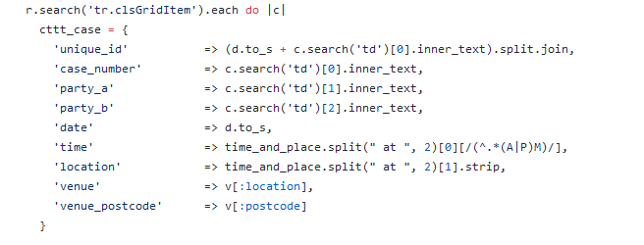
@henaredegan https://morph.io/henare/ncat-hearings

Slide 17
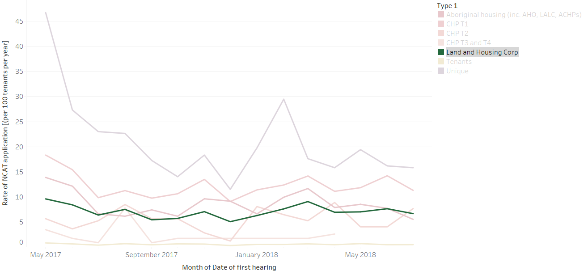
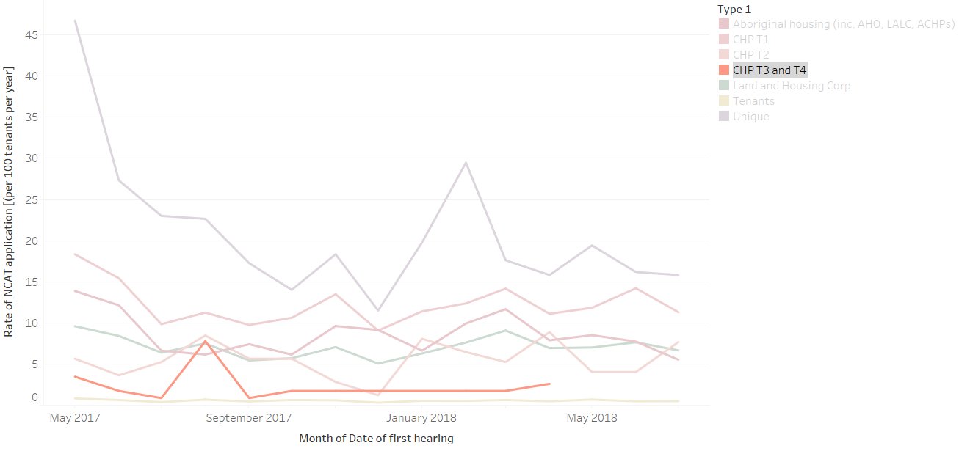
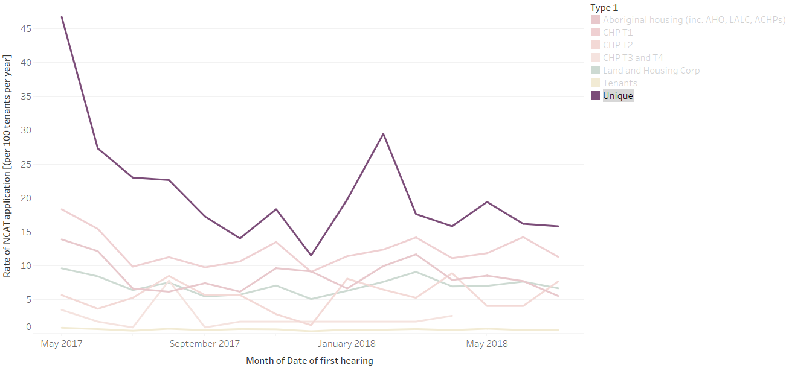
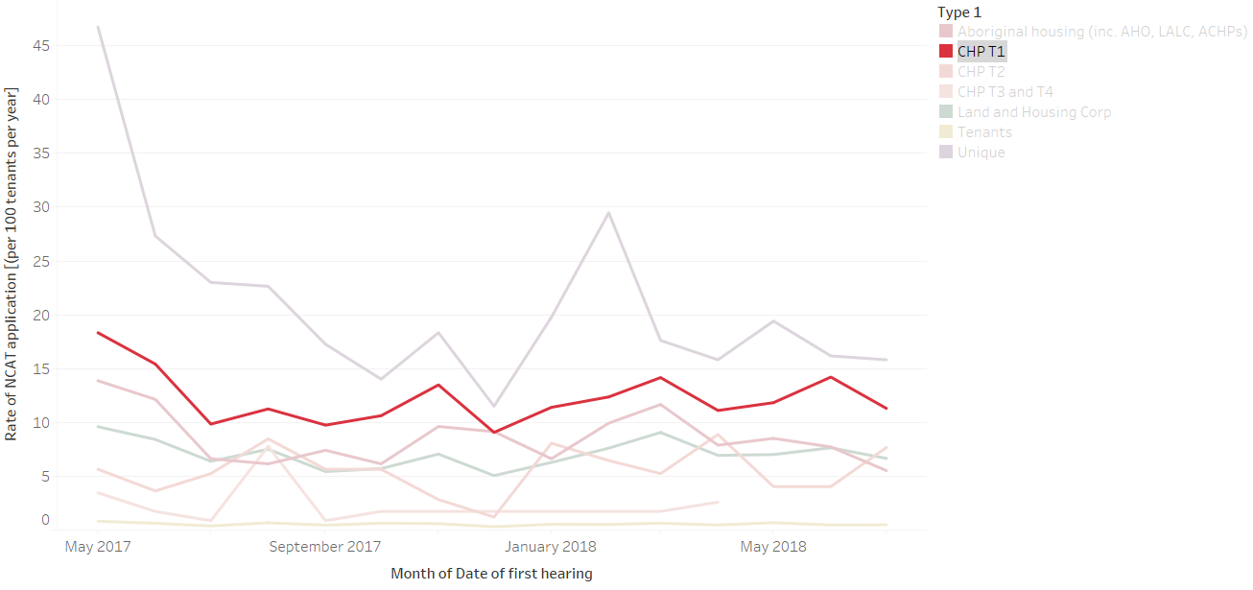

Slide 18
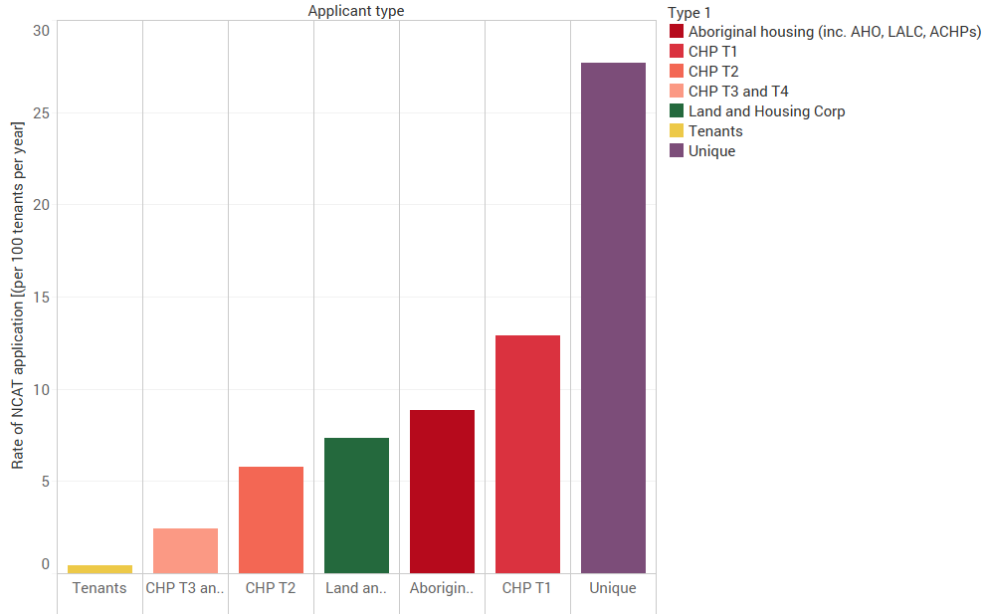
April 2017 to October 2017

Slide 19
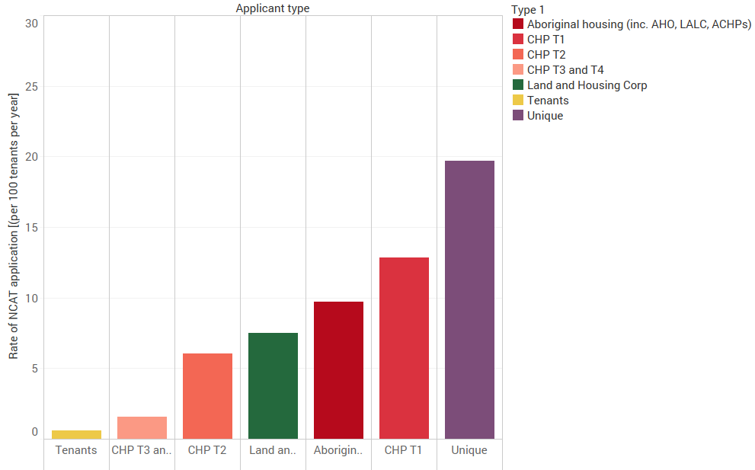
October 2017 to April 2018

Slide 20
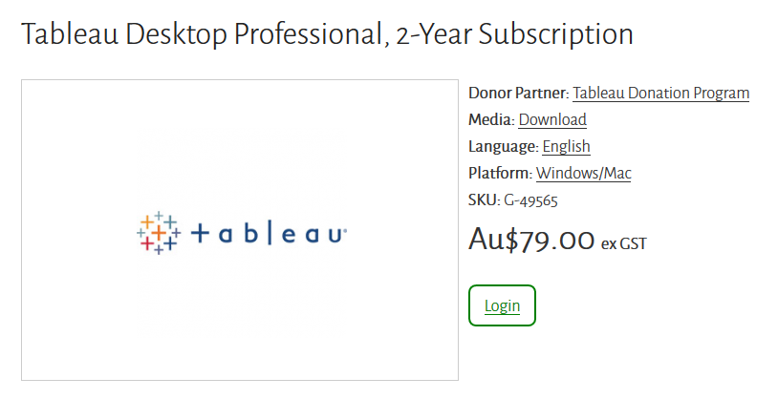
https://www.connectingup.org/donations/node/3400

Slide 21
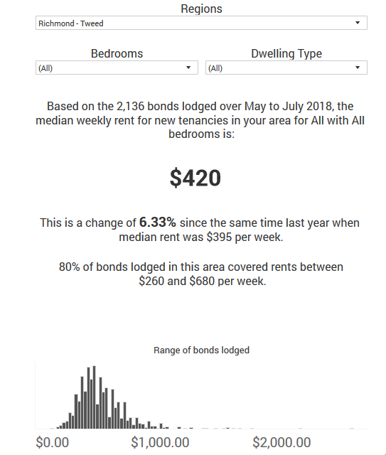
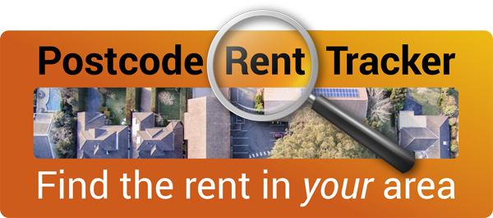
https://www.tenants.org.au/resource/rent-tracker-postcode-tool

Slide 22
Leo Patterson Ross
@TUNSW
@TUNSW
@leopatross
@rentingfairnsw
@MakeRentingFairNSW

